Slide 1

Basal Resources
Learning Module #14

Slide 2
Agenda
Time | Length | Activity
1:00 | 20 min | Opening Activity
1:20 | 1 hour, 30 min | Basal Resources in our Campus Stream
2:50 | 10 min | BREAK
3:00 | 15 min | Basal Resources in Stream Ecosystems
3:15 | 45 min | Basal Resources and Water Health
4:00 | 10 min | BREAK
4:10 | 20 min | Closing Activity

Slide 3
Opening Activity
Instructions:
Write your response to the questions on the lesson worksheet.

Slide 4
Opening Activity
Question 1: What do you know about the term “stream basal resources”?
Question 2: Imagine that you are a scientist that studies basal resources in streams. What are some basic questions you might ask basal resources in a stream ecosystem to better understand the health of a stream?

Slide 5
Basal Resources in our Campus Stream
We are going to take a field trip to our campus stream to see how researchers might sample stream basal resources (algae and leaves).
When we get back to the classroom, we will also be looking at some of our collected algae samples under the microscope!

Slide 6
Materials needed for field trip
Wading boots/backpacks
For leaf collection demonstration:
Quadrat
Measuring tape
Collection bag for leaves
For algae collection:
Whirl-pak bags
Sharpie

Slide 7
Observing live algae samples
Step 1: Preparation of wet mount slide
Materials needed:
Gloves
Sample from stream
Plastic tray for scraping algae substrates
Toothbrush
DI water
Plastic disposable pipette
Microscope slides
Coverslips (#1)
Sharps container
Colored pencils (for sketches)

Slide 8
Observing live algae samples
Step 1: Preparation of wet mount slide
Directions:
Put on gloves
Take out sample (substrate) from whirl-pak bag and place into plastic tray. Pour water from the bag into the tray.
Use to toothbrush to gently scrape your substrate. Try to scrape the surface at least 3x
Use DI water to rinse your substrate AND your toothbrush. NOTE: use as little water as possible! Using too much water will dilute your sample, making it difficult to observe algae.

Slide 9
Observing live algae samples
Directions, continued:
Collect 1 microscope slide and 1 coverslip from your instructor.
Pipette the sample water.
7. Place 1-2 drops of sample water onto microscope slide
8. Gently place coverslip on top of microscope slide.
Note: the microscope slide and coverslip are fragile!! If you break one, no worries, just come get a new one – and throw the old/broken one in the sharps container!!

Slide 10
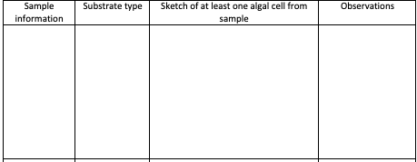
Observing live algae samples
Step 2: Algae observations
For each sample viewed, you will use your lesson worksheets to indicate:

Slide 11
Observing live algae samples
Example
This sample had a lot of the same kinds of algal cells called diatoms.
#1
Darren’s sample
Rock

Slide 12
Take
a
break!

Slide 13
Basal Resources in Stream Ecosystems
There are no guided notes this afternoon.
Feel free to take notes on your own, and raise your hand to ask questions!

Slide 14
Basal Resources in Stream Ecosystems
Basal resources are important to stream food webs because they are the producers of the stream/at the bottom of the food web.
There are two major types of basal resources in streams:
Leaves
Algae
Basal Resources
Baxter et al. 2005
Photo credit: Kkeenan3, CC BY-SA 4.0 <https://creativecommons.org/licenses/by-sa/4.0>, via Wikimedia Commons
Notes:
First, let’s look at basal resources. What are basal resources?

Slide 15
Basal Resources in Stream Ecosystems
When ecologists study basal resources in streams, they are often interested in two aspects of basal resources:

Slide 16
Basal Resources in Stream Ecosystems
When ecologists study basal resources in streams, they are often interested in two aspects of basal resources:
1. Quantity
How much of the basal resource is there in the stream?

Slide 17
Basal Resources in Stream Ecosystems
When ecologists study basal resources in streams, they are often interested in two aspects of basal resources:
1. Quantity
How much of the basal resource is there in the stream?
2. Type
What kinds of algae or leaves are in the stream?
Are algae or leaves the more important food source in the stream?
Changes in the quantity or type of basal resources can have major effects on stream ecosystem health!

Slide 18
Basal Resources in Stream Ecosystems
Leaves/Detritus
Quantity – how many leaves are in the stream? (What is the biomass of leaves in the stream?)
Type – what types of leaves are in the stream?
Notes:
Quantity of leaves – this is important because

Slide 19
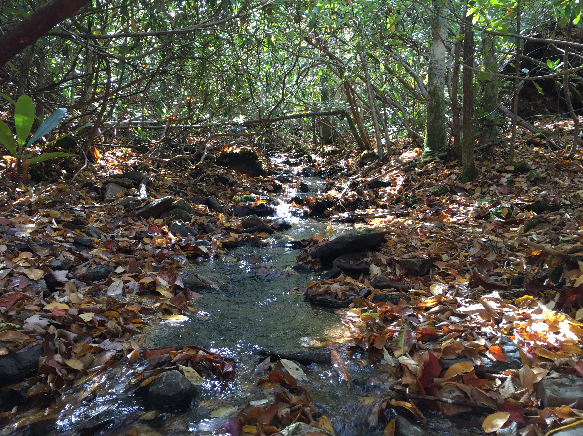
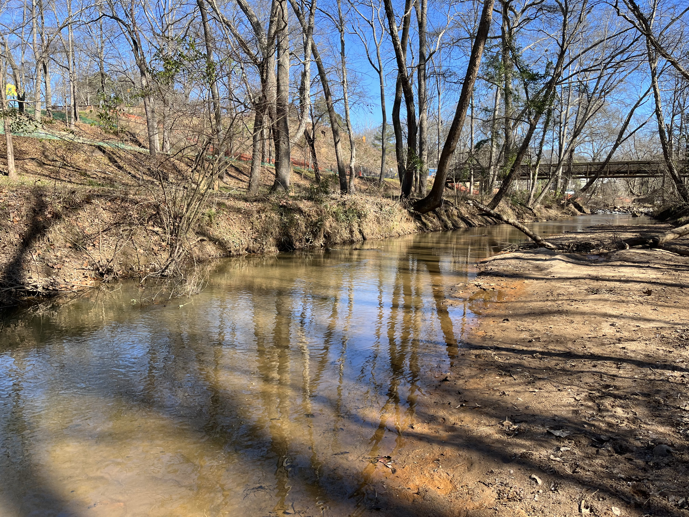
Basal Resources in Stream Ecosystems
Leaves/Detritus
Quantity – how many leaves are in the stream? (What is the biomass of leaves in the stream?)
Type – what types of leaves are in the stream?
Higher leaf biomass
Lower leaf biomass
The quantity of leaves in streams is important because many organisms rely on leaves as a food source!
Too little biomass of leaves can be a problem.
Notes:
Quantity of leaves – this is important because

Slide 20
Basal Resources in Stream Ecosystems
The type of leaves in streams is important
because leaves vary in their nutrition!
Too much of leaves with little nutrition can be a problem.
Leaves/Detritus
Quantity – how many leaves are in the stream? (What is the biomass of leaves in the stream?)
Type – what types of leaves are in the stream?
Photo credit: By Heath, Francis George - https://www.flickr.com/photos/biodivlibrary/6796245903,
Public Domain, https://commons.wikimedia.org/w/index.php?curid=43498384
Notes:
Quantity of leaves – this is important because

Slide 21
Basal Resources in Stream Ecosystems
Algae
Quantity – how much algae is in the stream?
Type – what types of algae are in the stream?
Notes:
Quantity of leaves – this is important because

Slide 22
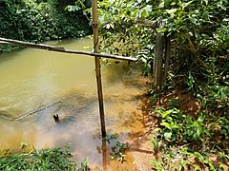
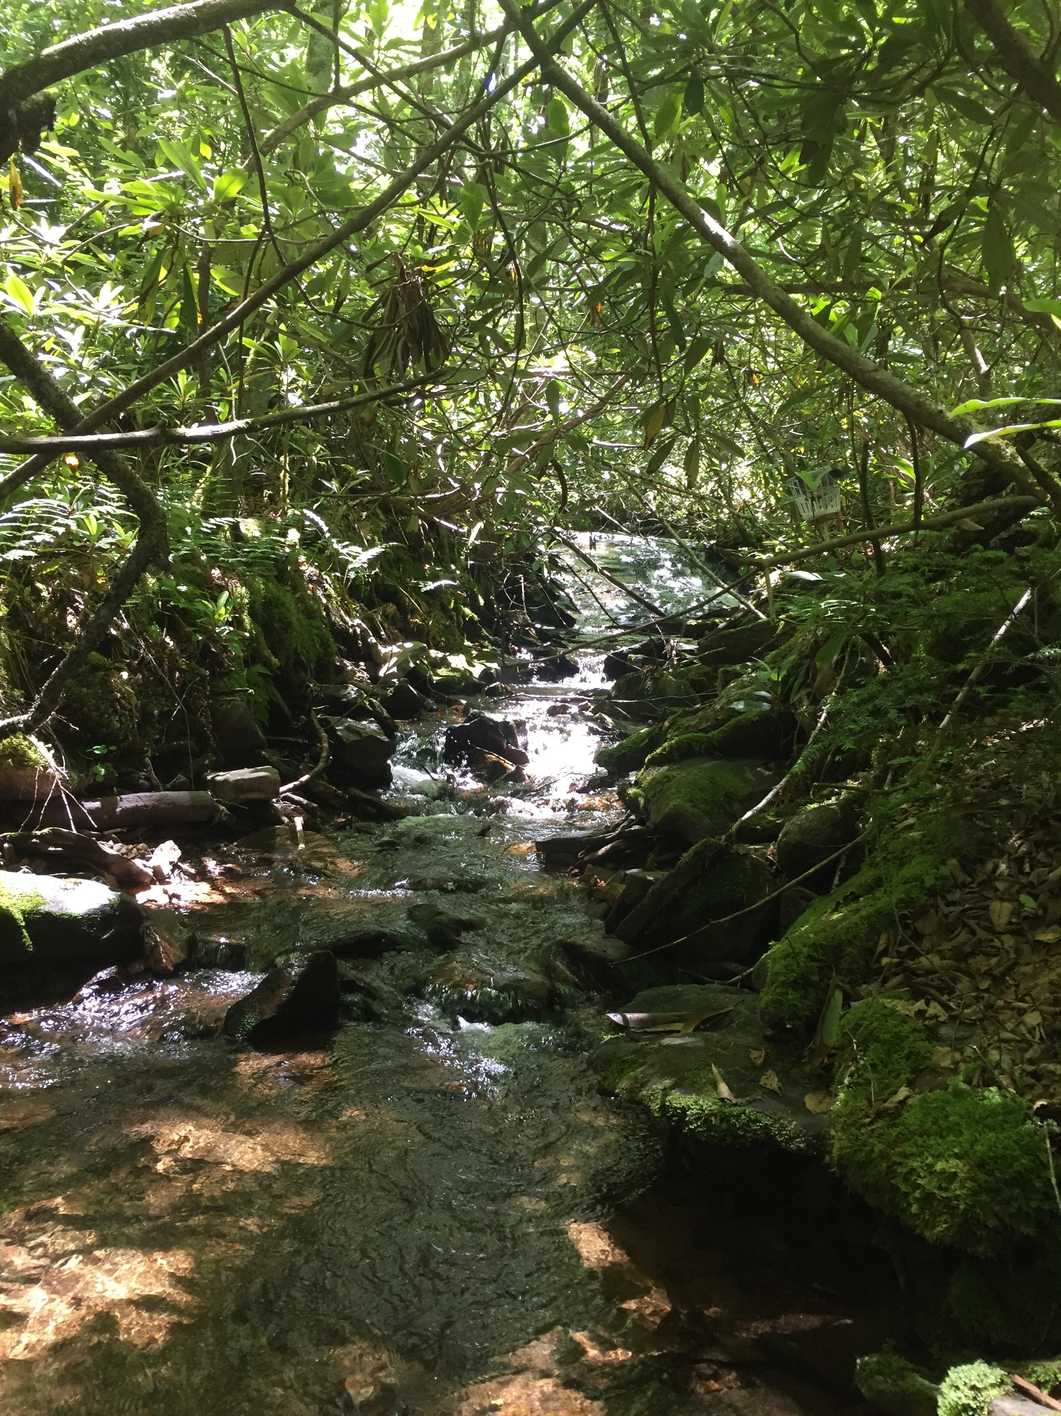
Basal Resources in Stream Ecosystems
Algae
Quantity – how much algae is in the stream?
Type – what types of algae are in the stream?
Higher algae biomass
Lower algae biomass
Photo credit: AfricanLibrarian, CC BY-SA 4.0
<https://creativecommons.org/licenses/by-sa/4.0>, via Wikimedia Commons
The quantity of algae in streams is important because many organisms rely on algae as a food source!
Too much or too little algae can be a problem.
Notes:
Quantity of leaves – this is important because

Slide 23
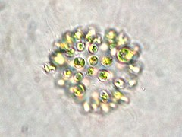
Basal Resources in Stream Ecosystems
The type of algae in streams is important because different types of algae vary in their nutrition.
Some types of algae are toxic and can become a big problem if present in large quantities.
Algae
Quantity – how much algae is in the stream?
Type – what types of algae are in the stream?
Diatoms!
Green algae!
Imrahil22, CC BY-SA 4.0 https://creativecommons.org/licenses/by-sa/4.0
, via Wikimedia Commons
Cyanobacteria!
(Blue-green algae)
Photo credit: Prof. Gordon T. Taylor, Stony Brook University,
Public domain, via Wikimedia Commons
Kristian Peters http://www.korseby.net/outer/flora/algae/index.html, CC BY-SA 3.0
<https://creativecommons.org/licenses/by-sa/3.0>, via Wikimedia Commons
Notes:
Quantity of leaves – this is important because

Slide 24
Basal Resources and Water Health
In this next activity, we will be learning about three real-life scenarios where changes in basal resources are affecting the health of aquatic ecosystems and/or those using the ecosystems.
After each video or reading, you will answer the three associated questions on your lesson worksheets. We will then discuss each scenario as a class!

Slide 25
Basal Resources and Water Health
Scenario 1: Dog death in Georgia (video)
https://www.11alive.com/article/news/a-marietta-couple-take-their-dog-to-lake-allatoona-less-than-an-hour-later-a-vet-tells-them-the-dog-might-have-died-from-algae-toxins/85-b8c44ca2-a390-4c4e-82a2-0e67ab29dd94

Slide 26
Basal Resources and Water Health
Scenario 2: Nutrient pollution damages stream (article reading)

Slide 27
Basal Resources and Water Health
Scenario 3: Fish kill in Australia (video)
https://www.youtube.com/watch?v=TkpRsY81FIg

Slide 28
Take
a
break!

Slide 29
Closing Activity
Instructions:
Write your response to the question on your lesson worksheet.

Slide 30
Closing Activity
Scenario: Imagine that you are tutoring a middle school student in science. You are looking at a picture of a river food web, points to a picture of algae, and asks, “What’s that? Why is it important?”
Question 1: How would you answer the student in ~3 sentences?

